Slide 1

Machine Learning for Stock Direction Prediction
A Project Implementing an ML Model with a Real-World Dataset
Prepared by: Abeer AlShehri, Abeer Alqarni
Dr. Abrar Wafa
Notes:
1

Slide 2










Project Overview & Objectives
Project Overview
Primary Goal
Developed a machine learning system to forecast daily stock price direction by integrating financial news sentiment and technical market indicators.
Project Scope
Construct and evaluate a predictive model capable of forecasting whether a stock's closing price would rise or fall on the subsequent trading day.
Developed as a prototype for predictive modeling
Not intended to function as an operational trading system
Key Constraints
Key Approaches
Data Limitation: Absence of timestamps in news data prevented temporal correlation with stock prices
  Technical indicators from historical price and volume data
  Sentiment indices based on financial news
Dataset Size: Final dataset of 1255 samples was relatively small
Machine Learning for Stock Direction Prediction
2 / 10
Notes:
2

Slide 3
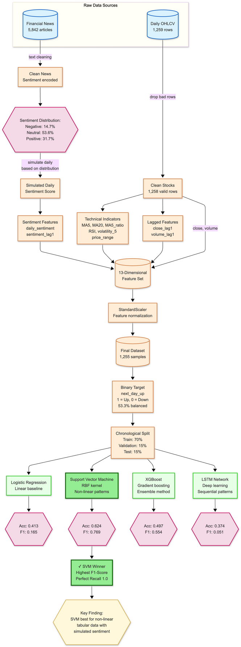










System Diagram and Models Used
Features
Algorithm Selection
Trend Indicators
  ma5
Logistic Regression
Support Vector Machine
  ma20
  ma5_ratio
Baseline model
Non-linear patterns
Price & Volume Basics
XGBoost
LSTM
  close
  volume
Ensemble learning
Sequential data
  price_range
Momentum & Volatility
Robust Evaluation Approach
  rsi
  volatility_5
Chronological Data Split
Temporal Memory
Training Set
Validation Set
  close_lag1
Test Set
  volume_lag1
70%
15%
15%
Sentiment Features
Training
Validation
Test
  daily_sentiment
  sentiment_lag1
Machine Learning for Stock Direction Prediction
3 / 10
Notes:
4

Slide 4

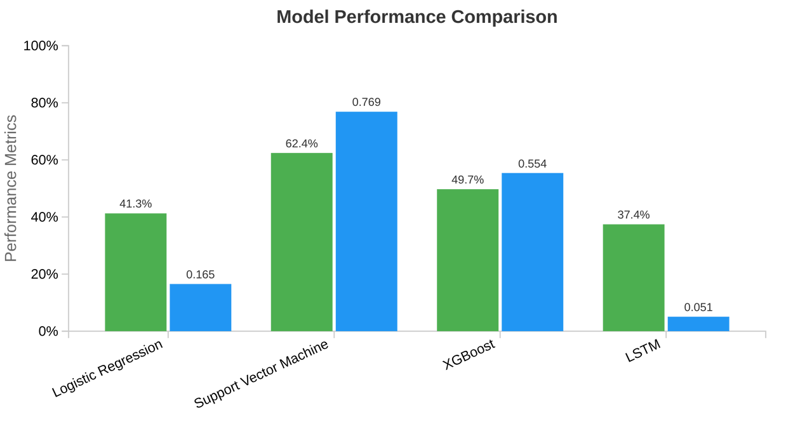



Findings & Results
SVM Emerges as Top Performer
Support Vector Machine achieved 62.4% accuracy and 0.769 F1-Score
Key Insights
SVM's Strength: High recall value of 1.0 correctly identified all "up" days
LSTM's Weakness: Poor performance with F1-Score of 0.0508
XGBoost's Balance: F1-Score of 0.5540 showing balanced precision and recall
Logistic Regression: F1-Score of 0.1654 confirming non-linear relationships
Accuracy
F1-Score
Machine Learning for Stock Direction Prediction
4 / 10
Notes:
7

Slide 5














Critical Project Limitations
Despite successful model implementation, several critical limitations affected the project's outcomes:
Simulated Sentiment Data
Single Stock Focus
Reliance on simulated news sentiment rather than genuine, time-stamped data. This limits real-world predictive power.
Model developed exclusively on data from one stock, limiting generalizability across broader markets.
Basic Feature Set
Static Sentiment Simulation
Relatively simple feature engineering. More sophisticated technical indicators could enhance performance.
Simulation didn't account for dynamic relationships between sentiment spikes and market volatility.
Impact Assessment
These limitations collectively restrict the model's real-world applicability. Addressing them would require acquiring better data sources and expanding the feature set.
Machine Learning for Stock Direction Prediction
5 / 10
Notes:
8

Slide 6












Future Work Recommendations
Key improvements to enhance the stock direction prediction system:
Timestamped News Data
Expanded Dataset
Advanced Features
Acquire news articles with exact publication dates for accurate sentiment correlation with stock movements
Utilize 5-10 years of data on multiple stocks for a larger, more diverse dataset
Explore sophisticated technical indicators and macroeconomic data
Ensemble Modeling
Backtesting Framework
Develop an ensemble of best-performing models to combine their individual strengths
Develop a comprehensive financial backtesting framework that models actual trades, including realistic transaction costs
Machine Learning for Stock Direction Prediction
6 / 10
Notes:
9

